Slide 1
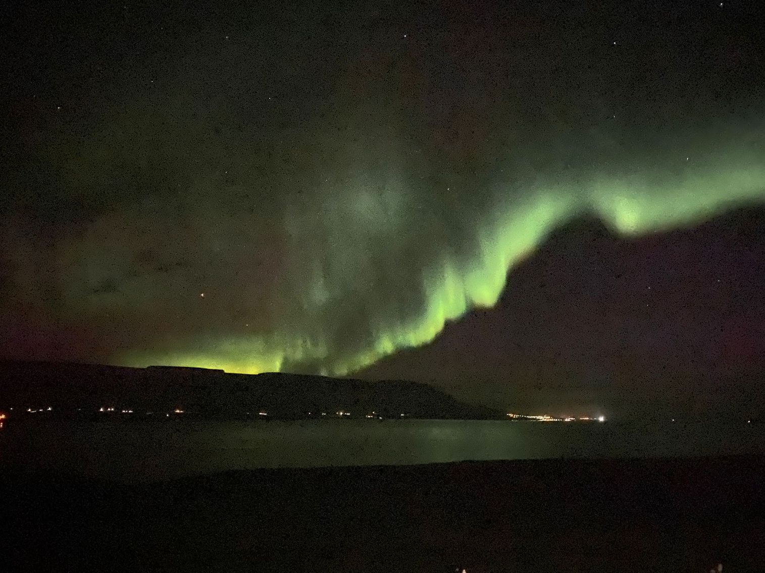
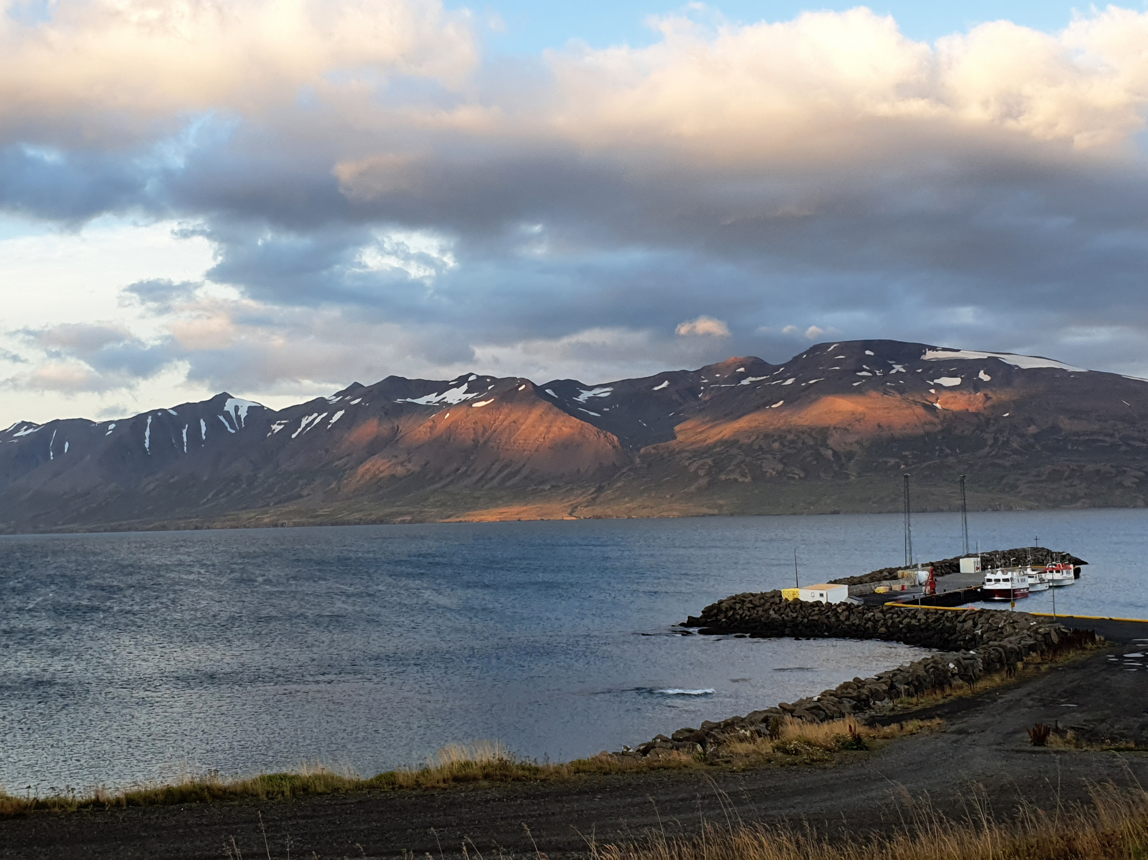
North Iceland Food Excellence
Development of a food storytelling template for use by SMEs

Slide 2
Contents
The case study group
Introduction/methodology/instructions
The storytelling template
Step 1 – understanding the benefits of storytelling for your business
Step 2 – building your story with the GROW model
GROW in practice – 2 live case studies
Simple guide to creating your story
Step 3 - who are your customers/audience for the story
Step 4 - developing your story
Story types and Icelandic examples
Step 5 – delivering your story
Step 6 – engaging people in your story
Step 7 – owning your story
Owning your story – writing advice
Top tips for successful stories
Further reading, resources and links

Slide 3
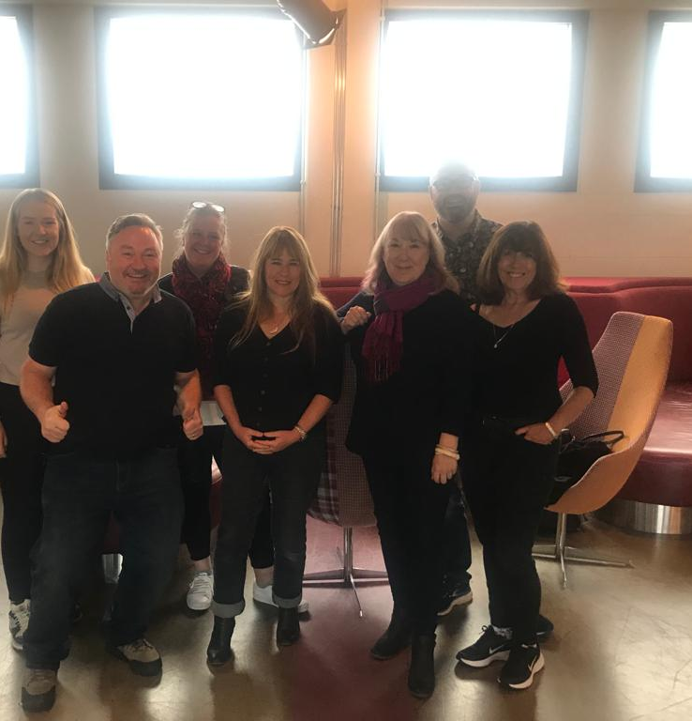
Case study group
Lily Reade, Isle of Mull Cheese
Stephen McDonach, Lochaber Environmental Group
Carron Tobin, Rural Dimensions
Janet Gordon, Blue Starfish Consulting
Sandra Reid, Fare Consulting
Neil Beattie, Shetland Islands Council
Hilary Knight, Hilary Knight Food and Drink Ltd

Slide 4
Introduction/methodology and instructions for use
This case study was developed by a group attending the Erasmus+ learning journey to North Iceland from 12-19 September 2021.
Our objective was to develop a template for use by SMEs to tell their food and drink story. We have used examples of experience and best practice gathered during the learning journey as well as from businesses we work with in the UK.
This document serves as a ‘how to’ guide for businesses to use to develop their food story. The template is a word document for users to print off. It follows a step by step process; users should take each step at a time without jumping ahead! You should aim to complete the template over a period of time and not all in one go.
While you can complete the template yourself, we recommend you use it with an independent guide, for example a trusted advisor or colleague, perhaps someone from a local food group – but ideally not from your own business or a family member as they (and you) may have some preconceived ideas.

Slide 5
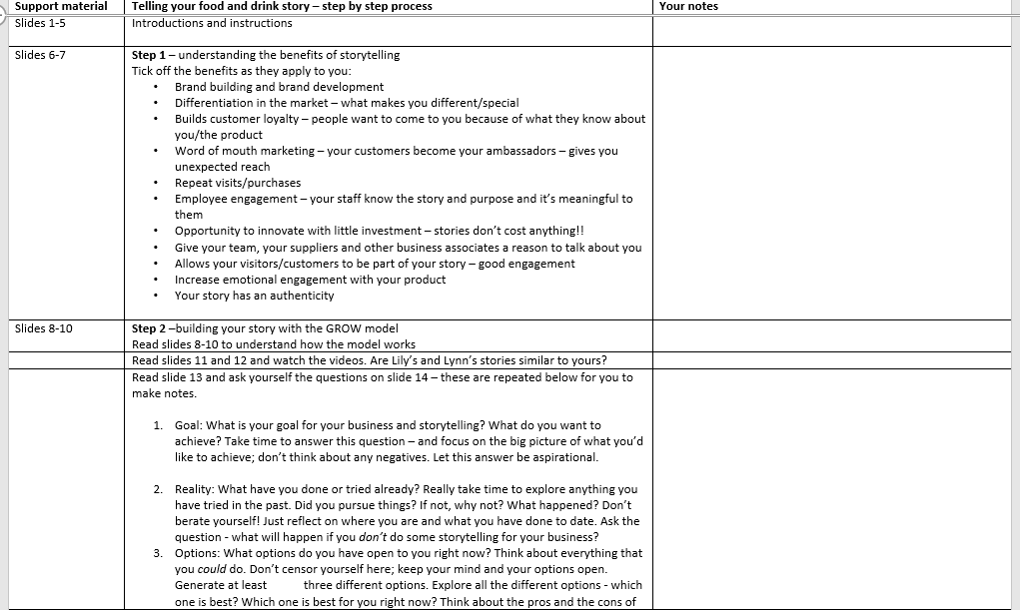
The storytelling template
Print off the word document or fill in electronically if you prefer.
There are 3 pages in total and you should make notes where you wish.
As before, aim to do this with a colleague.

Slide 6
Step 1 – understanding the benefits of story telling
We all know we should tell stories about our business or organisation to connect with people. But it’s hard to find the time to do this in the daily cut and thrust of running a small business – usually when the owner is looking after everything from putting out the bins to making coffee and emptying the dishwasher.
On the next slide, we’ve outlined some of the many benefits that businesses experienced when they do take time to weave story telling in to their marketing and other aspects of their business.

Slide 7
Benefits of storytelling
Brand building and brand development
Differentiation in the market – what makes you different/special
Builds customer loyalty – people want to come to you because of what they know about you/the product
Word of mouth marketing – your customers become your ambassadors – gives you unexpected reach
Repeat visits/purchases
Employee engagement – your staff know the story and purpose and it’s meaningful to them
Opportunity to innovate with little investment – stories don’t cost anything!!
Give your team, your suppliers and other business associates a reason to talk about you
Allows your visitors/customers to be part of your story – good engagement
Increase emotional engagement with your product
Your story has an authenticity that big brands have to create (Captain Birdseye, Werther’s… and so on)

Slide 8
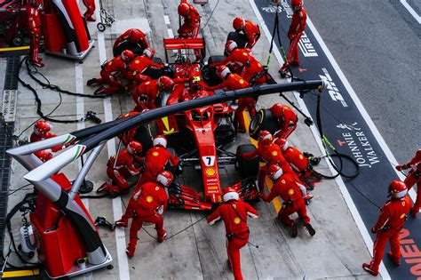
Step 2 - build your story with the GROW model (and ask some tricky questions too…)
Sir John Whitmore was a racing driver who worked with the team in the F1 pit, to find out how they could get more efficient and give him the edge in a race. He asked them questions to find out their opinions for improvement – rather than telling them his opinion. Afterall – they were the ones doing the work and so had the most knowledge and experience of the task. His team had lots of ideas to shave off vital seconds. This approach was so successful he then developed the GROW model which is a core business coaching tool.
The GROW model is a great tool to help people get clarity about what sort of story they want to tell and how much time they have or want to have to dedicate to “story telling”.
GROW is a simple set of questions that will guide you through your thinking – as well as asking some tricky questions.

Slide 9
GROW Model (Sir John Whitmore)

Slide 10
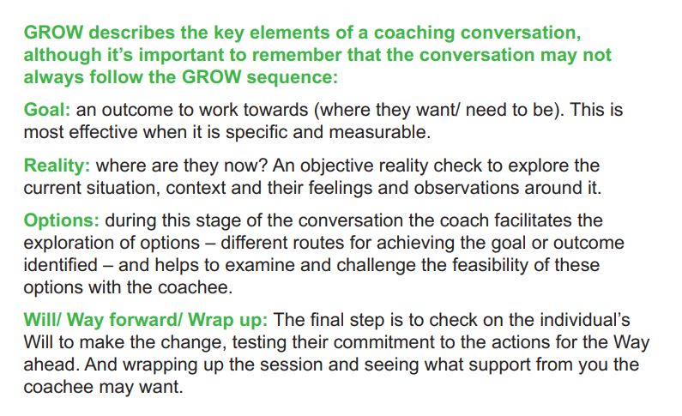
GROW model

Slide 11
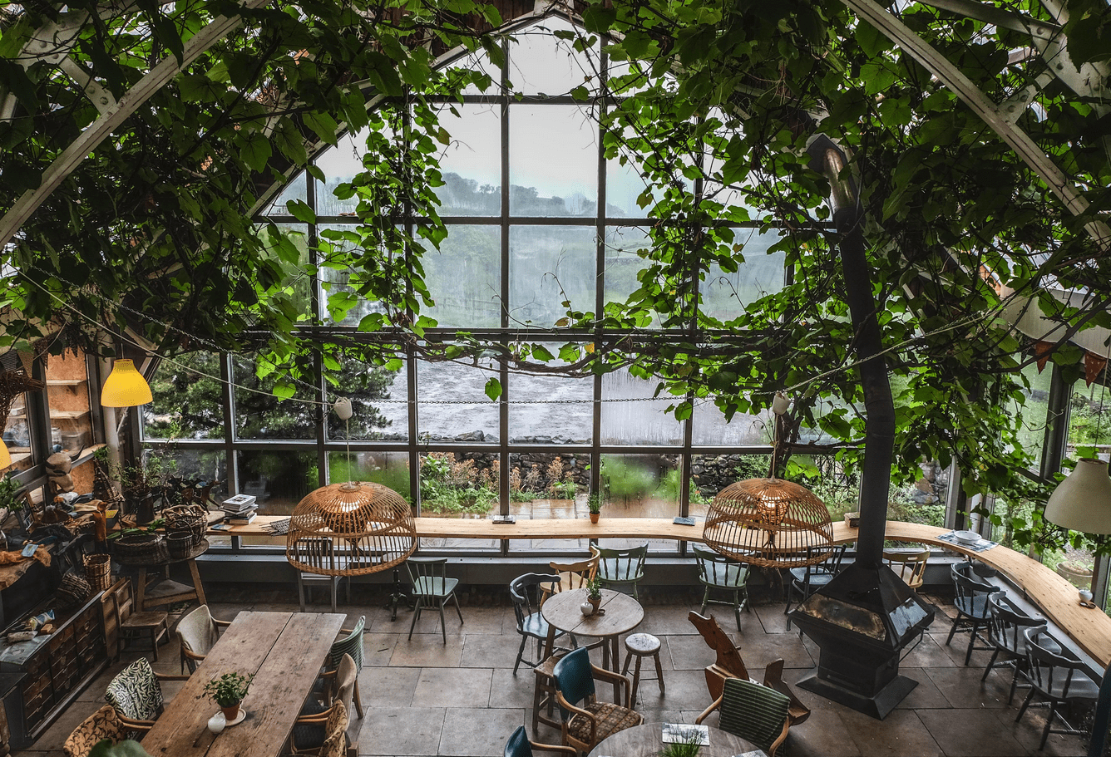
GROW in practice – (1)Lily Reade
During our visit to North Iceland, we used the GROW model to explore the storytelling ambition and potential of 2 fellow travellers who run SME food and drink businesses in Scotland.
In this video, Janet speaks with Lily from Isle of Mull Cheese and Glass Barn Café, Isle of Mull Home | Isle of Mull Cheese (sgriobruadh.co.uk)
We used the GROW model to help Lily focus on what she needs to do in her marketing and communications role. Notice that we don’t offer her any suggestions – we let her come to her own opinions. There’s nothing more annoying than a consultant or advisor giving you advice without really having understood your situation. With story telling….you are the one who has all the stories and the GROW model will help get you some clarity on your own thoughts.

Slide 12
GROW in practice – (2) Lynn Johnson
In this next video, Neil speaks to Lynn from the Original Cake Fridge and Tearoom Shetland The Cake Fridge - Shetland - Home (facebook.com)
As a small business owner, Lynn has very little time for marketing or story telling. We used the GROW model to help her get some clarity on what she needs to do.
See if you can follow the steps of the GROW model in this short interview.

Slide 13
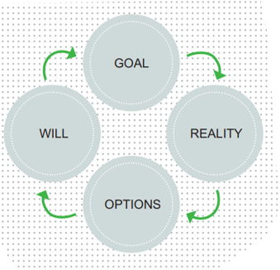
Build your own story with the GROW model
The next slide suggests some questions to help you start building your story. If you have a friend or colleague who can ask you these questions, that would be best. If not, find 20-30 minutes and give yourself time to really think through each question.
GROW stands for:
Goal – what do you want to achieve?
Reality – What have you done so far? What obstacles have you faced?
Options – What options do you think you have available to you?
Will/way forward – How motivated are you to do this? What is your first step?

Slide 14
GROW questions for story building
Goal: What is your goal for your business and story telling? What do you want to achieve? Take time to answer this question – and focus on the big picture of what you’d like to achieve; don’t think about any negatives. Let this answer be aspirational.
Reality: What have you done or tried already? Really take time to explore anything you have tried in the past. Did you pursue things? If not, why not? What happened? Don’t berate yourself! Just reflect on where you are and what you have done to date. Ask the question….what will happen if you don’t do some story telling for your business?
Options: What options do you have open to you right now? Think about everything that you could do. Don’t censor yourself here; keep your mind and your options open. Generate at least three different options. Explore all the different options - which one is best? Which one is best for you right now? Think about the pros and the cons of your option. Test it out. Make sure it’s something you feel excited about – other wise it won’t happen!
Will/Way forward: How motivated are you to do this? On a scale of 1-10 where 10 = Very Motivated and 1= Not at all……You need to have a score of at least 8 to know you a going to be bothered to do this ! And what are your first steps? How much time can you allocate to this?
Use the template to complete this step of the storytelling process.

Slide 15
Simple guide to creating your story
Who is your audience?
Your customers/victors/ guests
What story do you want to tell?
Develop your story
Engage people in your story
Deliver your story
Keep evolving your story
Now you have
A clear idea of your objectives and business goals
An understanding of options open to you
The motivation to push ahead
It’s time to start telling your story – but how will you do it?
Again take it step by step as shown in the diagram.

Slide 16
Step 3 – who is your audience?
Customer | When they visit | Where are they from | Specific interests
Foodies
Culture seekers
Business travellers
Families
Industry interest
It’s really important to identify who the various audiences are for your business – as their specific interest in your story might vary from group to group.
Write down who are your customers/visitors/guests using the template; think about the timing of their visit, where they are from and any specific needs or interests
If you have different aspects of the business with different audience groups choose one to start with. You may need to focus your story differently for each group or tell a different story.
Think about what will be important and interesting to you chosen audience group. Spend time gathering all the different stories or details you could tell. Then choose the most relevant parts for the audience group.
Consider cultural sensitivities – some funny stories might not hit the mark with certain groups

Slide 17
Step 4 - developing your story
All stories need a beginning, a middle and an end.
When you have your story, you can choose to experiment with how you tell it. Perhaps you start in the middle…or the end. It’s your story – so see what is most engaging.
There are, apparently , only 7 types of story in the world and through history. Christopher Booker has give the list a modern twist.

Slide 18
7 universal stories* (*Christopher Booker; The Seven Basic Plots)
Overcoming the monster - Beowulf, War of the Worlds, Game of Thrones
Rags to riches -Cinderella, Jane Eyre, Pretty Woman
The quest - The Iliad, Lord of the Rings, Star Wars
Voyage and return – Alice in Wonderland, Toy Story, Where the Wild Things Are, The Little Prince
Rebirth - Sleeping Beauty, A Christmas Carol, The Shawshank Redemption
Comedy – A Midsummer Night’s dream, Four Weddings and a Funeral
Tragedy - Hamlet, The Godfather

Slide 19
What type of story is yours?
We took a look at some of the stories we heard in Iceland and applied the ‘story type’ to them:
Elvar – Rags to Riches/Overcoming the Monster
Matt - Quest/Voyage and Return
Hekta and Julia – Quest/Overcoming the Monster
Look at the examples and think about which story type applies to you.

Slide 20
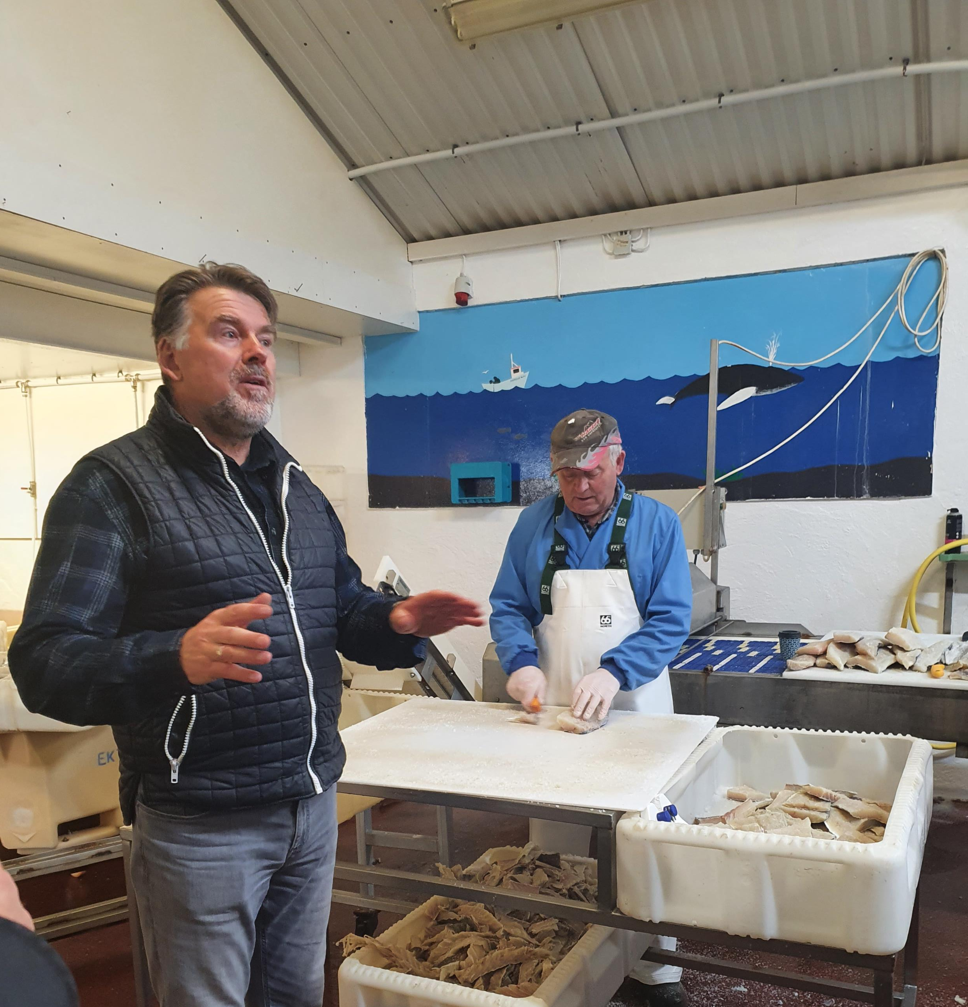
Elvar’s Story – Ektafiskur
Elvar is a third generation business owner, working alongside his brother and grandson. The business Ektafiskur - produces salt cod, mainly for the Spanish market, alongside a bar/restaurant and campsite. Hot tubs and facilities for campervans have recently been added.
We met Elvar face to face and he tells his story in a very personal way, explaining the family history and future plans which include his grandson. He naturally puts the story into context by giving the history behind the current business.
He uses humour throughout his story. He was honest explaining how he was nearly bankrupt but turned things around by being entrepreneurial and being different.
Perhaps Elvar’s story is ‘rags to riches’ or even ‘overcoming the monster’

Slide 21
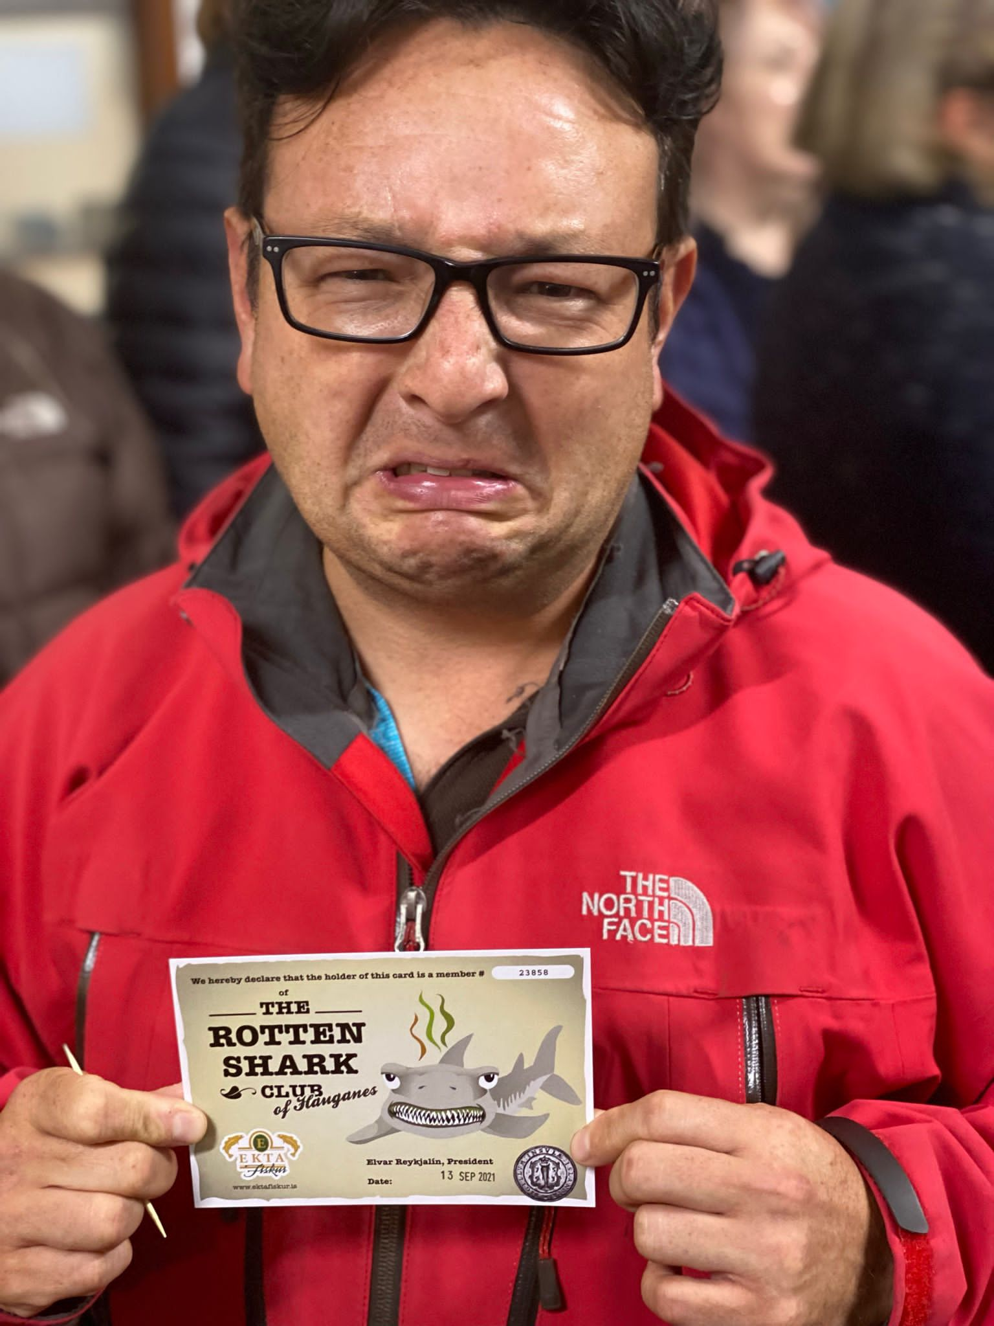
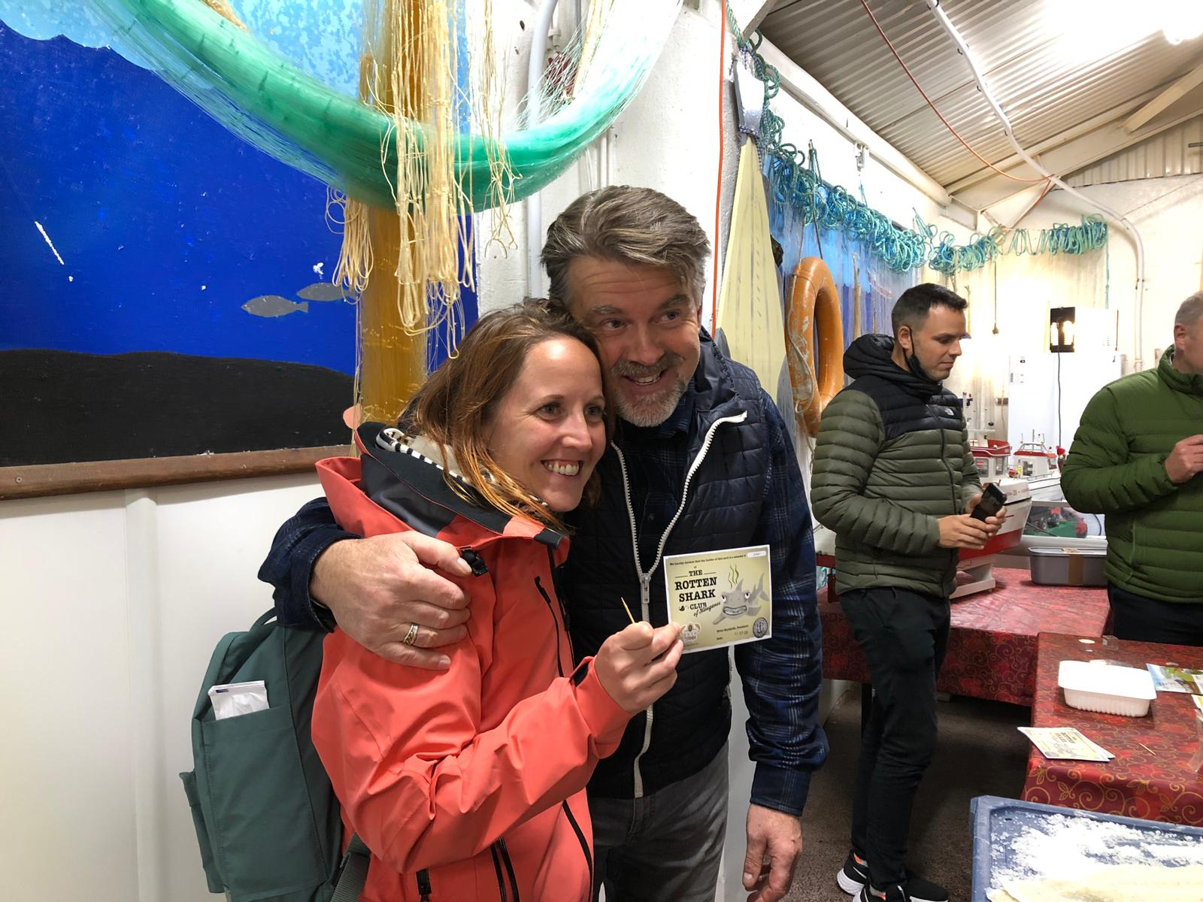
Elvar’s story – what makes the difference?
Elvar interacted throughout his story telling and engaged with his audience.
Elvar made full use of his extrovert personality and reinforced his business’ point of difference e.g. starting the Rotten Shark Club declaring himself president and personally presenting certificates to participants.
Ways Elvars’ ‘story telling’ could be enhanced were:
Making better use of social media to reach a wider audience and to continue the engagement of those he has met face to face.
Using Facebook to ‘diarise’ his story throughout the year – the summer months being very different to the winter months. Potential to use his grandsons’ generational skills to be engaged more in social media – Facebook, Instagram,Tik Tok.

Slide 22
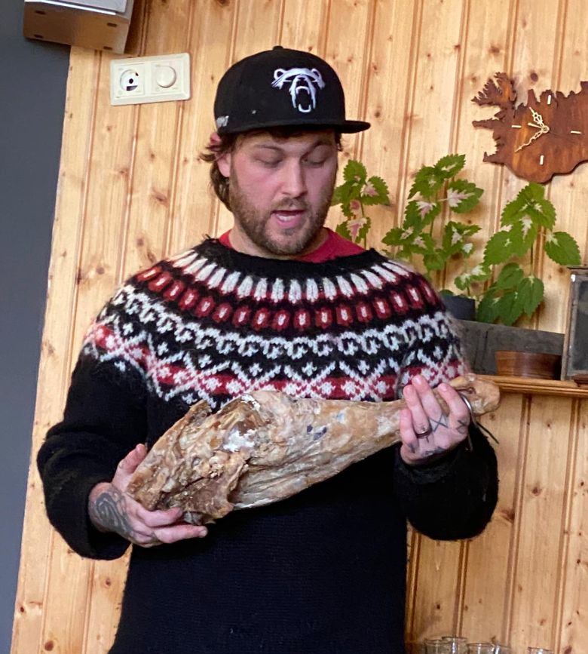
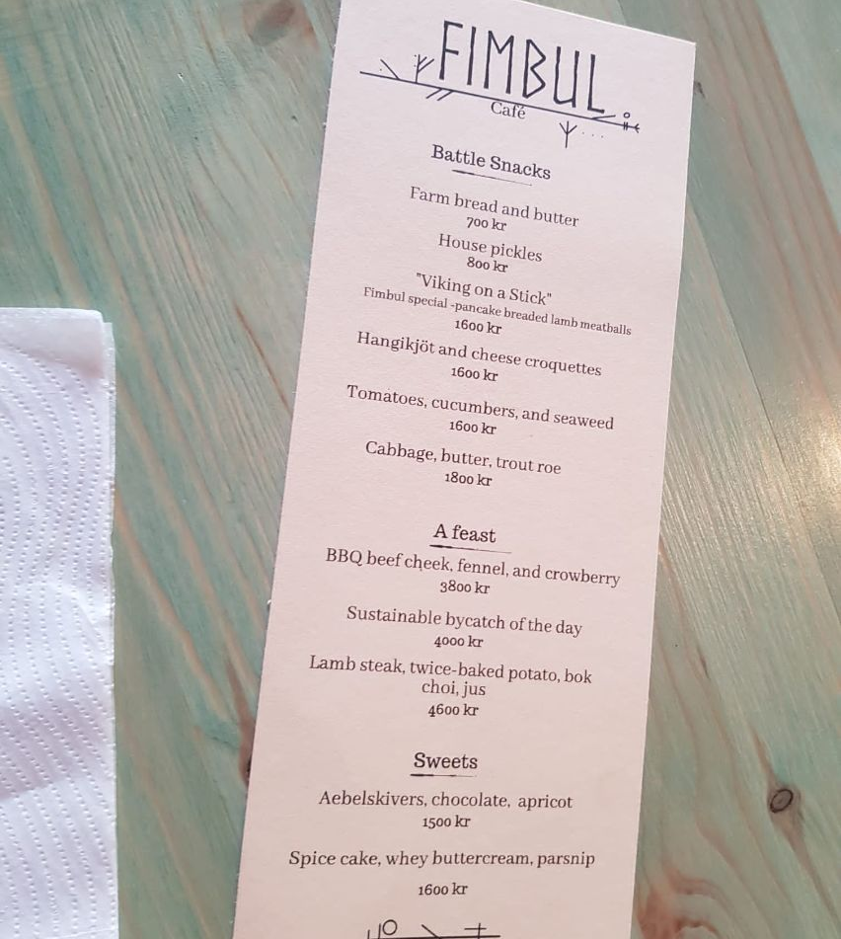
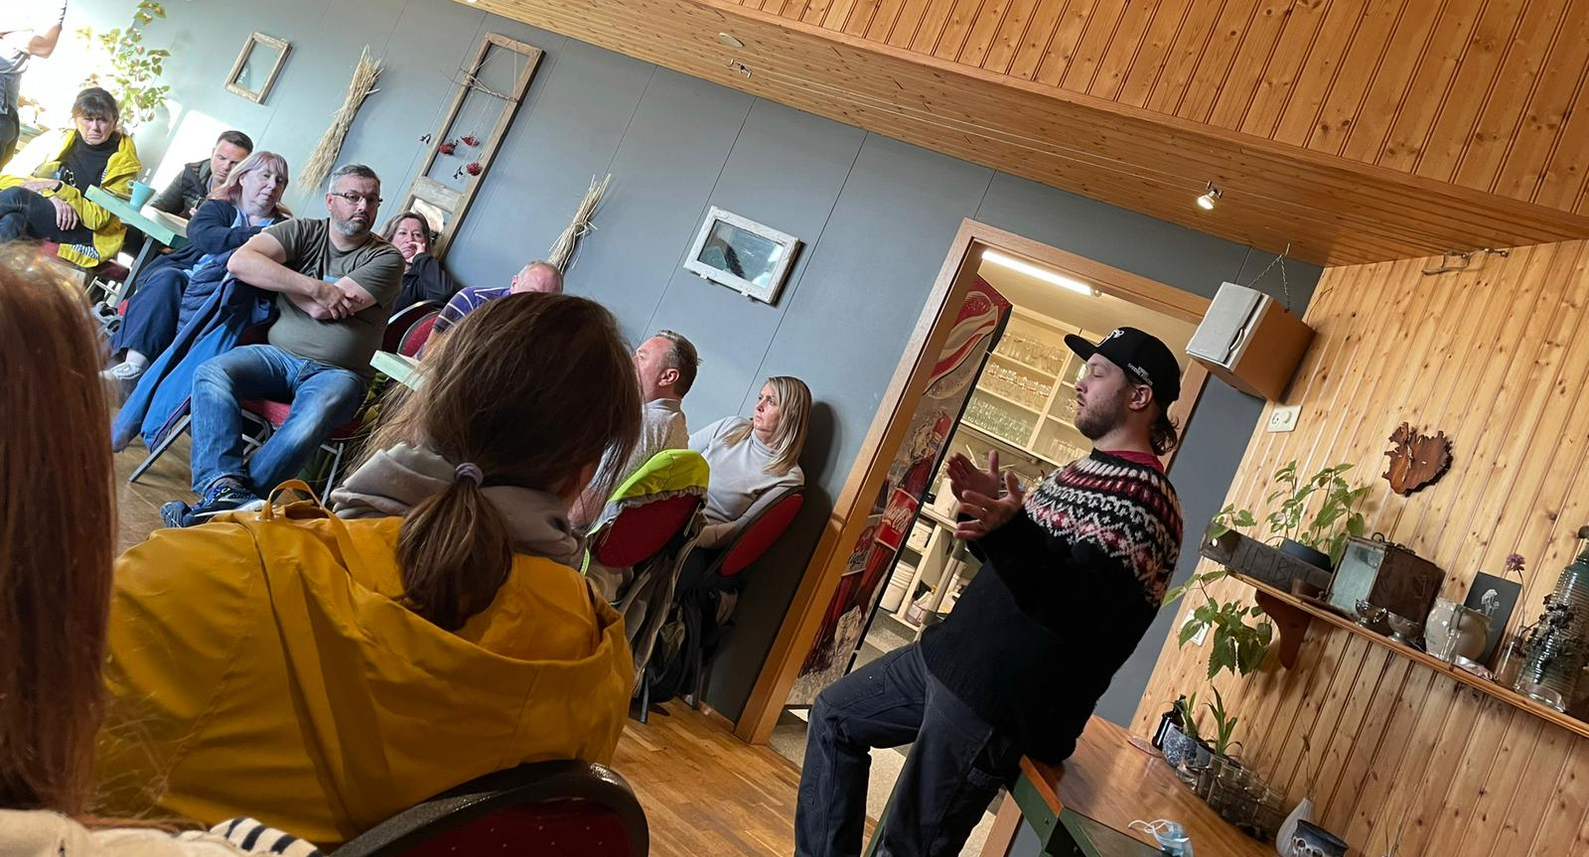
Matt – Lamb Inn Lamb-Inn | Facebook - a story of ‘voyage and return’
Matt is a chef from Portland USA who has travelled and discovered a deep passion for Icelandic food and agricultural traditions.
After Matt’s initial trip to Iceland, he returned to track down the origin of many traditional Icelandic recipes, food production and cooking methods – including a specific smoking technique
Matt’s ‘odyssey’ included meeting an elderly Icelandic heroine who helped him understand traditions on the ground – and this lit in him a desire to help preserve but also embrace these in contemporary cuisine
How did he tell it ?
Again Matt told his story very personally. He spoke from the heart and was honest and transparent with no gloss, telling us his life story and quest to discover and use traditional methods of Icelandic food production
The story is also told in the very creative menus and online via FaceBook with quirky dishes such as Viking on a Stick
Matt also used props - he showed us a smoked leg of lamb from the kitchen to illustrate the smoking technique he has been on a quest to perfect
This was all memorable primarily due to his very quiet laid back manner yet deep passion and sense of belief in the local product and cuisine.

Slide 23
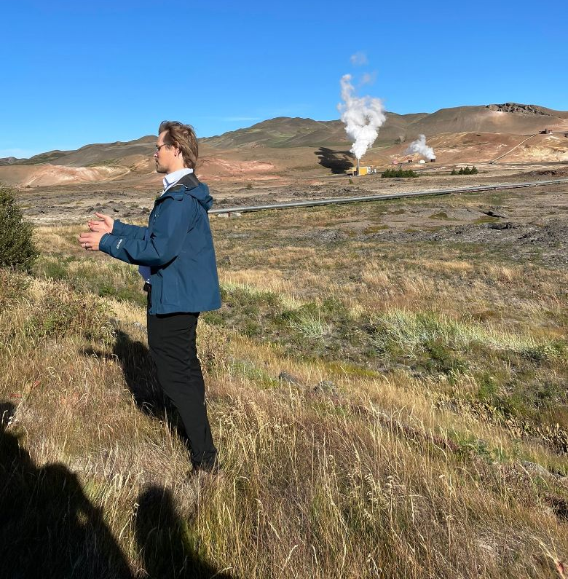
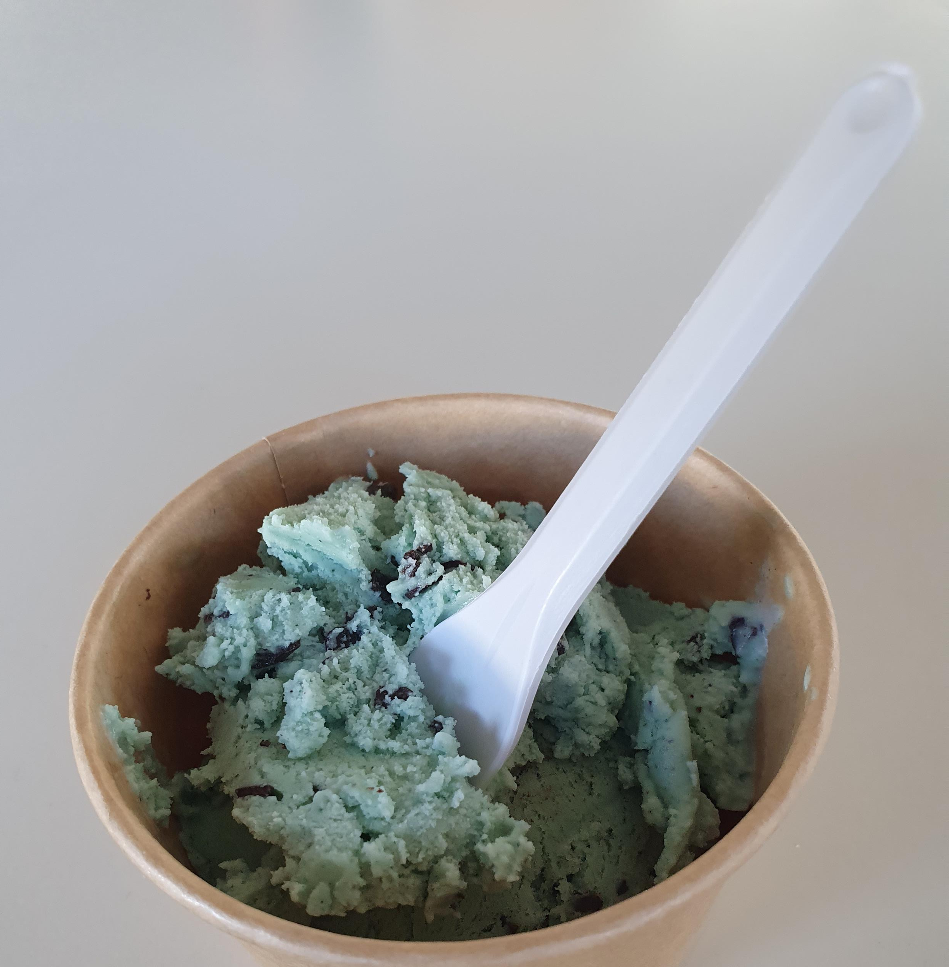
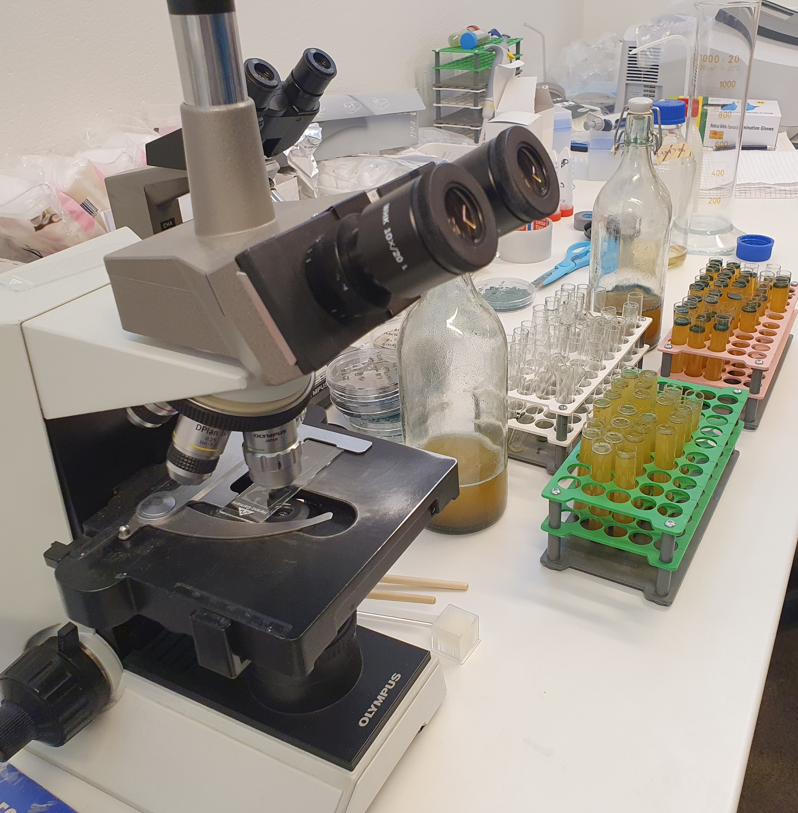
Hekta and Julia’s Story – From Volcanoes to Spirulina Ice Cream
Hekta and Julia (vulcanologist and biologist) are working together to extract spirulina from algae found in geothermal waters around Skutustaoahreoppur; a recent development for them is spirulina ice cream.
They were a great ‘double act’ each telling their part of the story in a direct and entertaining way; they are working with the land and the environment rather than against it.
This was another example of a quest story; or even overcoming the monster (the volcano).

Slide 24
Step 5 – delivering your story
Where are you going to tell your story?
Face to face - this works really well when you are taking groups or individuals on tours of your premises or perhaps talking at a seminar, workshop or conference. In Iceland, Matt, Elvar and Hekta were great natural storytellers speaking directly with their audiences.
In print – this could be on posters or other interpretation boards at your location; in leaflets, books and newsletters
Via social media – Facebook, Instagram, website, blogs, podcasts and video storytelling
The solutions here are endless; take a look at the examples following for inspiration.

Slide 25
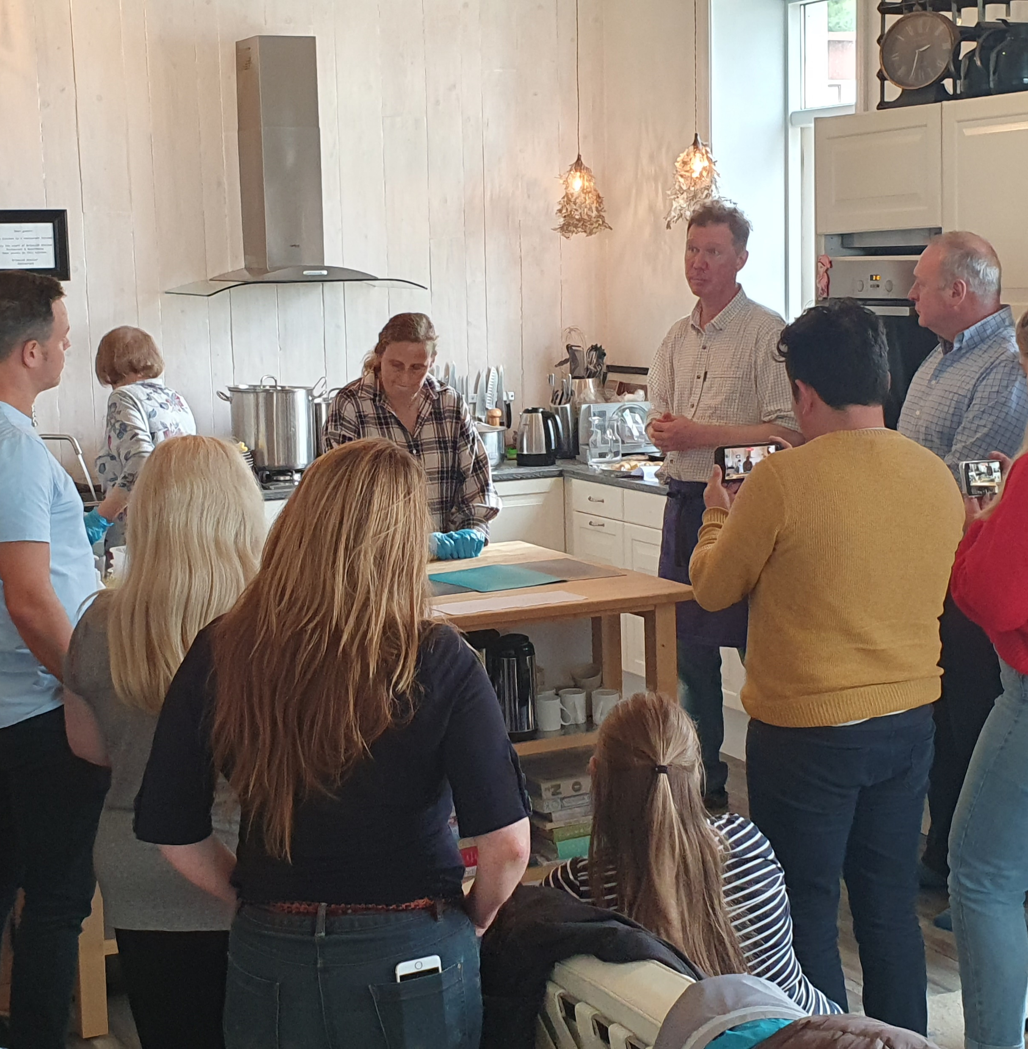
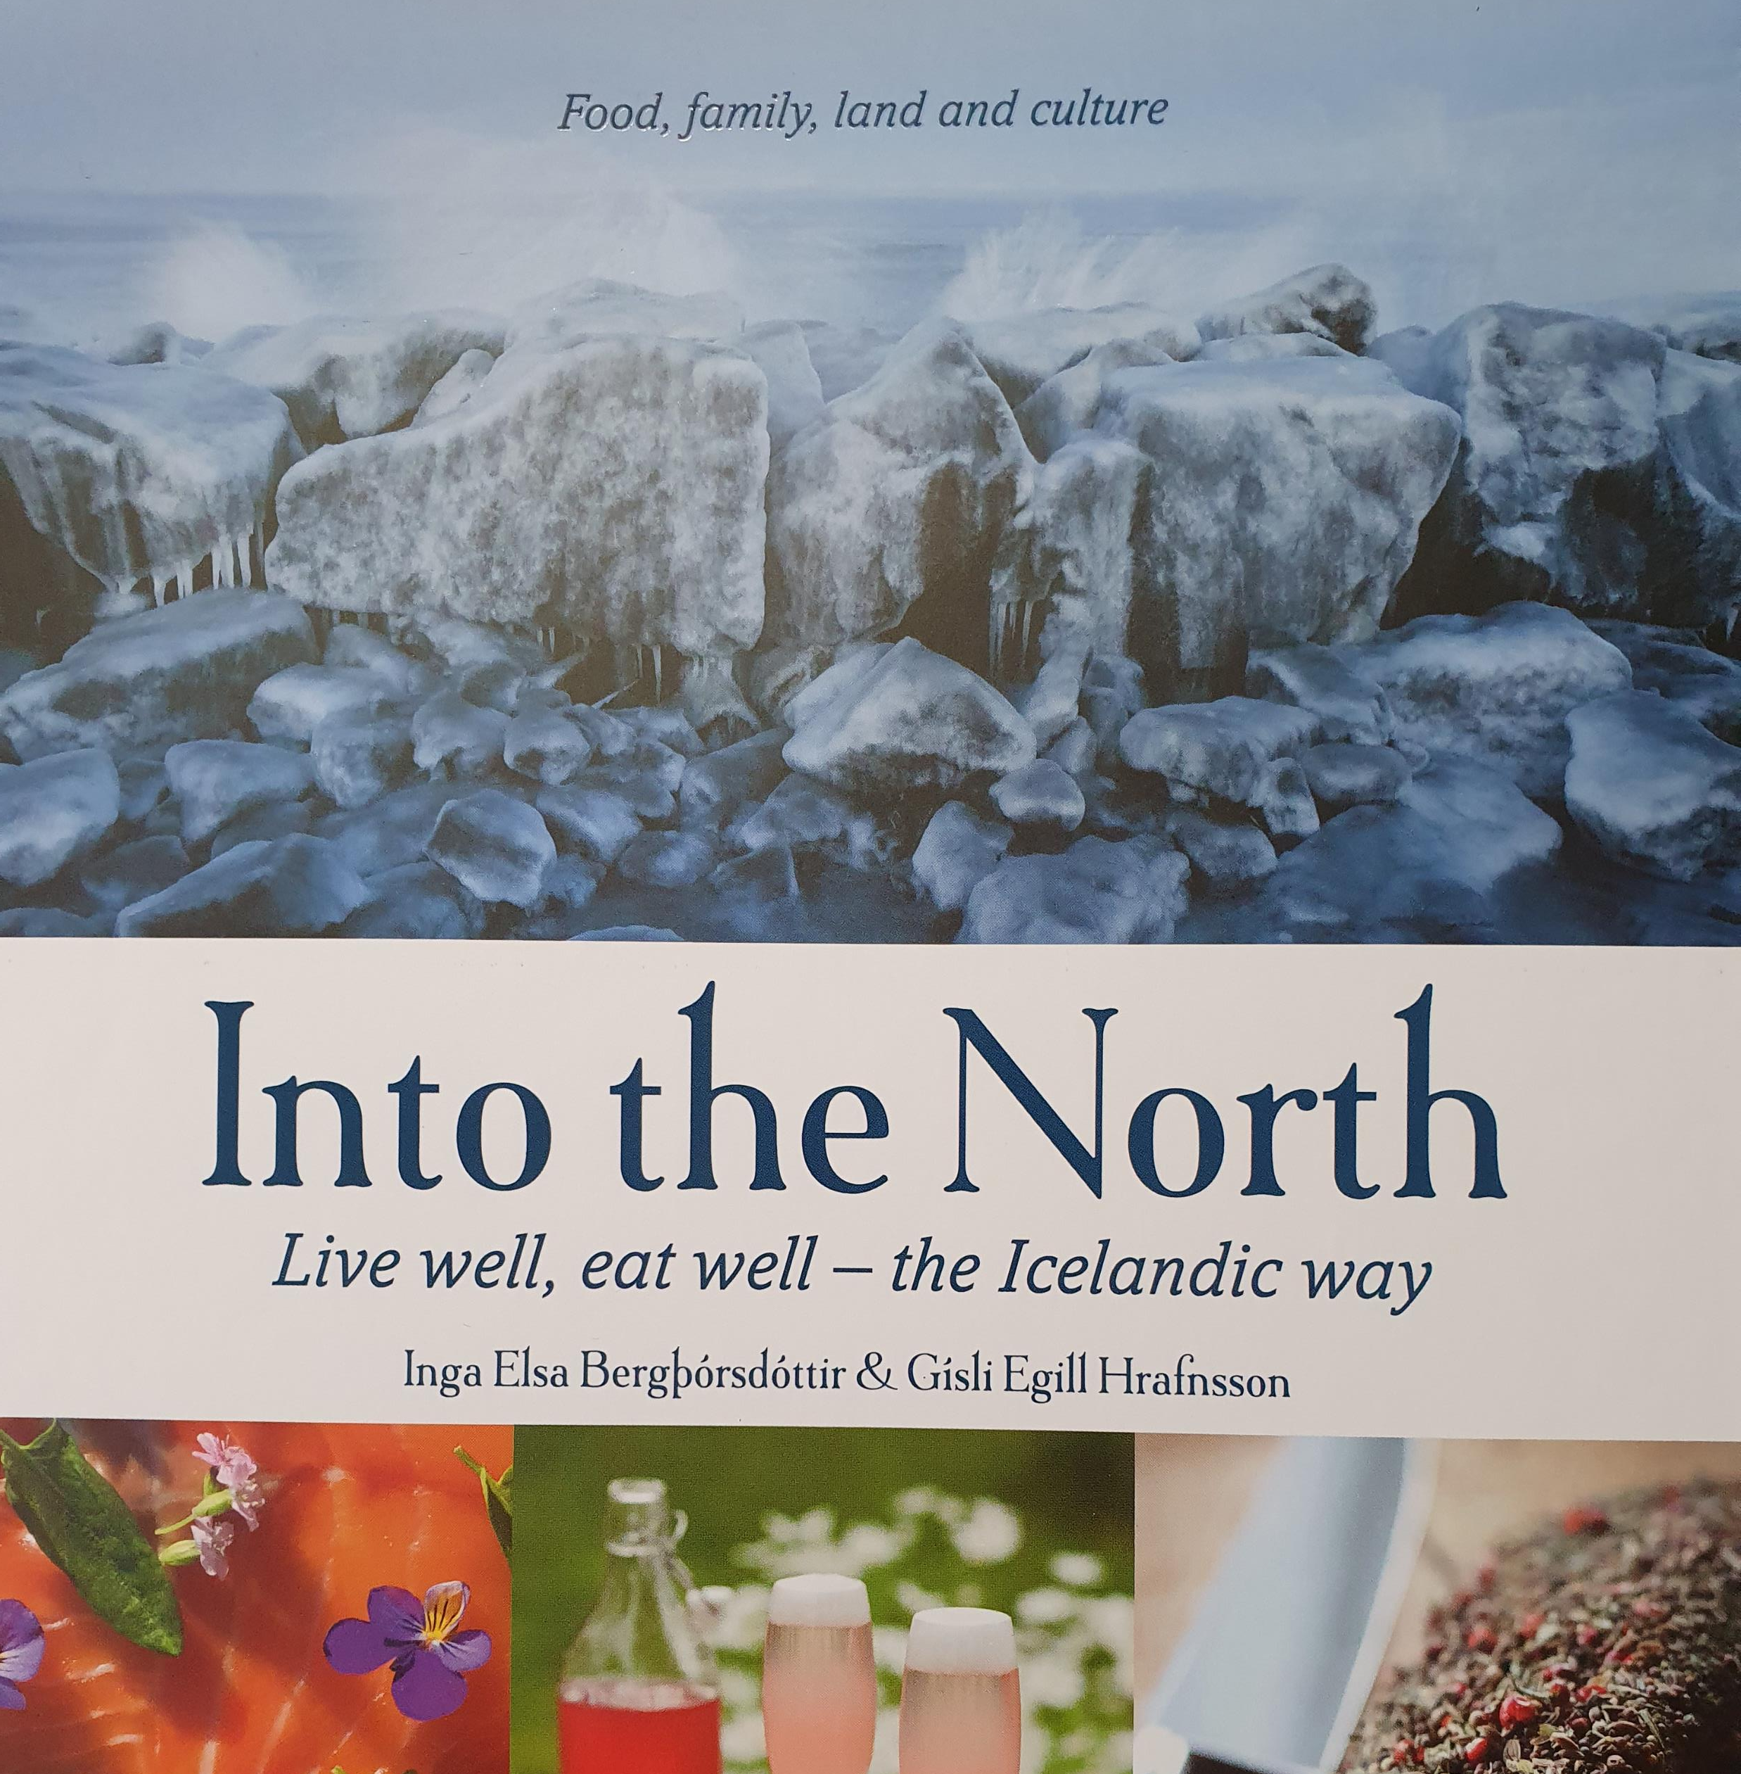
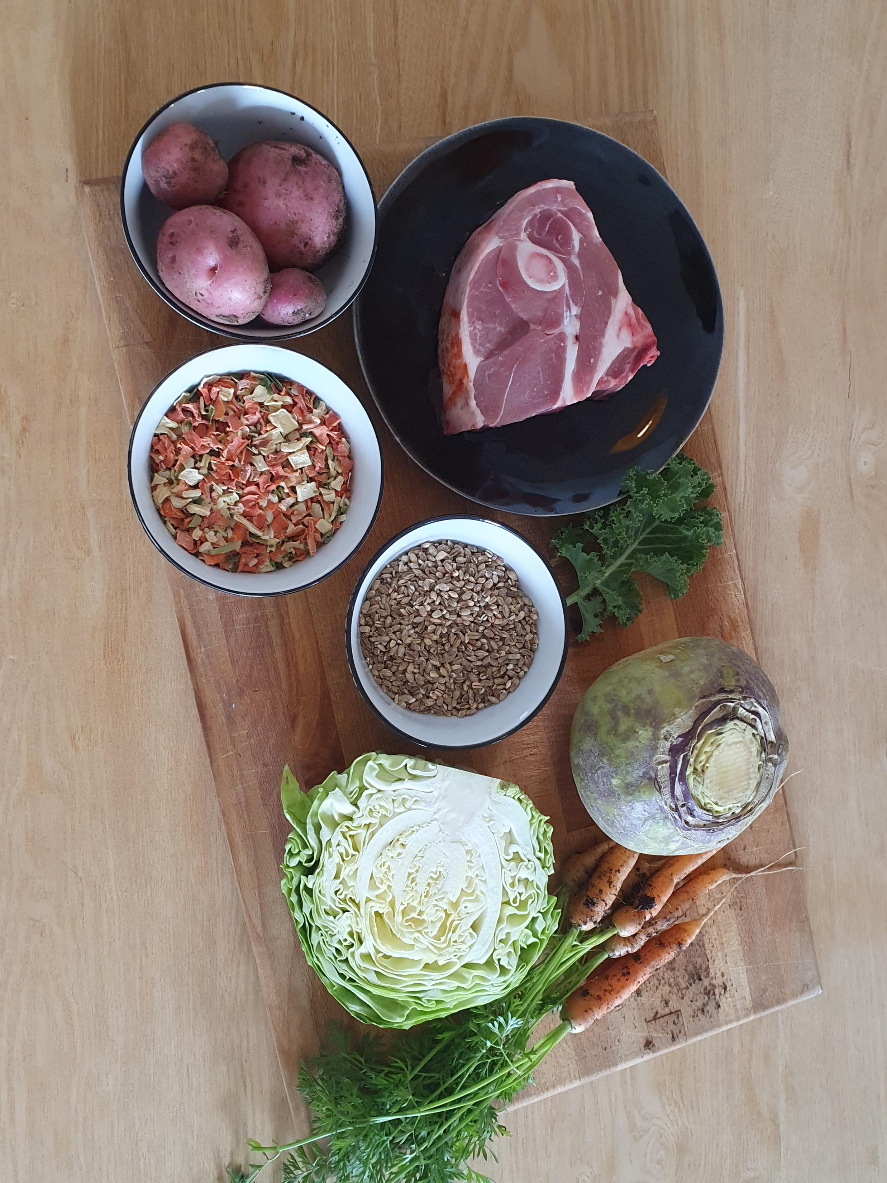
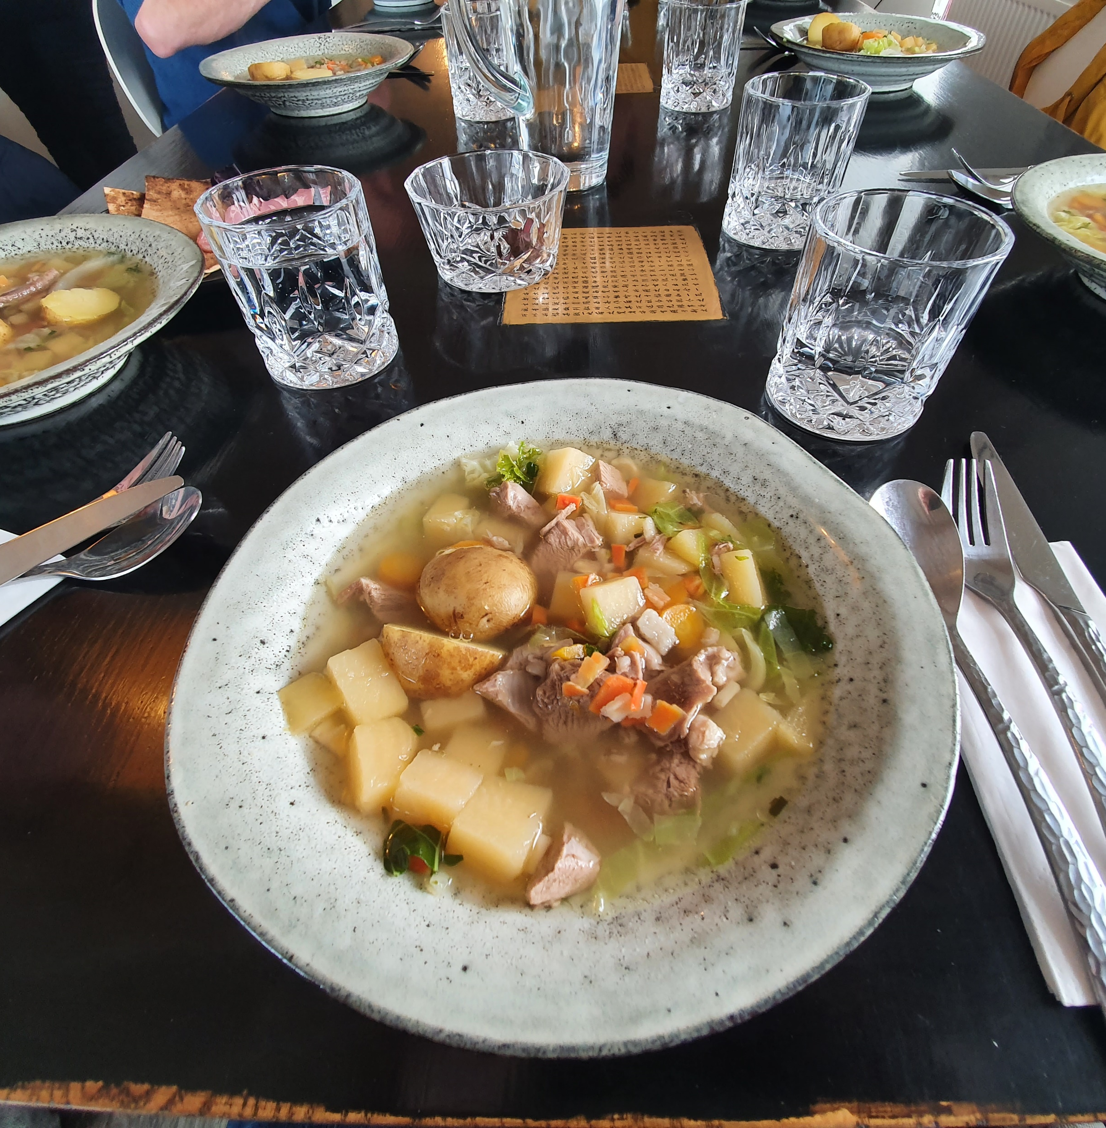
Telling your story in print Brimslóð Atelier Guesthouse (brimslodguesthouse.is)
Inga and Gisli (and mama!) at Brimslod Atelier told their story in many different ways - in person, demonstrating recipes and techniques and through their fabulous food.
As food photographers and writers, they have also produced several books, telling their own story, the local food story and demonstrating the heritage of Icelandic food and its connections with the land, sea and seasons.

Slide 26
Telling stories in newsletters
Here’s a great example of storytelling in a newsletter; it’s chatty, funny and has a call to action too – from Trenchmore Farm in West Sussex
Wagyu ragu in the yard, and a fond farewell to our feathered friends (mailchi.mp)
Mailchimp is an ideal tool for newsletter storytelling

Slide 27
Telling stories in posters and interpretation – Viking Sushi Cruises
A small cruise boat in Stykkisholmur that does a “Viking sushi trip”.
How: This consists of a 2 hour boat trip around the waters and uninhabited islands, together with a scallop sushi lunch and bowl of soup. The scallops, together with a variety of shell fish and sea life are dredged up from the sea bed , the scallops are selected and opened for sushi and afterwards the rest of the catch is thrown back into the sea.
Why: Ostensibly to tell the Viking stories and myths that surround the islands, look at the wildlife and eat a possible “Viking meal”.

Slide 28
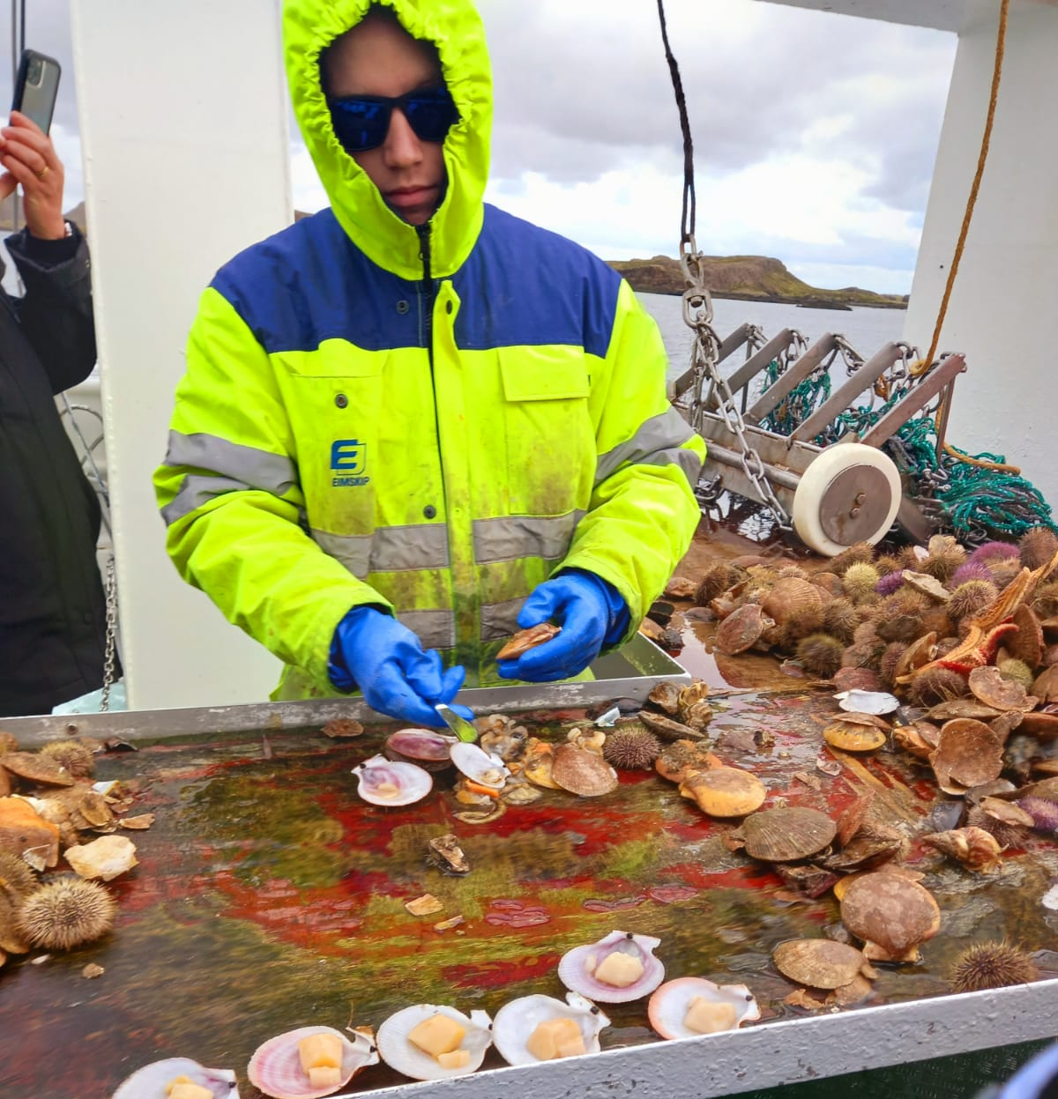
Viking Sushi Adventure Voyage = lessons learned
We felt that there was a lot of room for improvement. The stories read by the skipper were lacklustre and not delivered well. Although Vikings were referenced, and some bird species and habits, there could have been a much more engaging story teller. In the harbour café and shop, there were very good display boards with pictures and names of all the wildlife that could be seen in the area – these were not of the boat. There was an opportunity missed to help visitors explore their own journey and ”story” whilst onboard.
The customer service was not of the usually high Icelandic standard we had become accustomed to. It was very transactional. There was no engagement from any of the staff and no connection. The scallop sushi was delicious – but the men shucking them did not even give eye contact with the visitors. The quality of the coffee and the soup served was of a much lower standard than we had experienced previously. 6000 Krona is charged per person. A few simple improvements would make this experience much better and memorable for the right reasons.

Slide 29
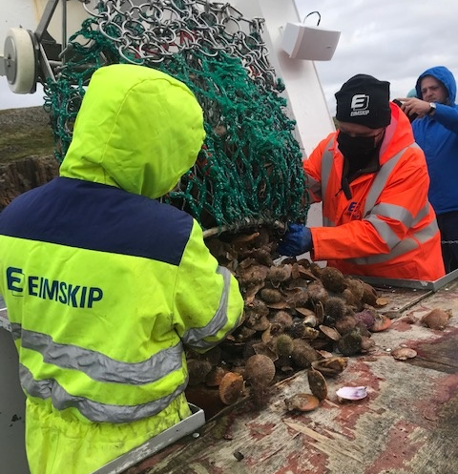
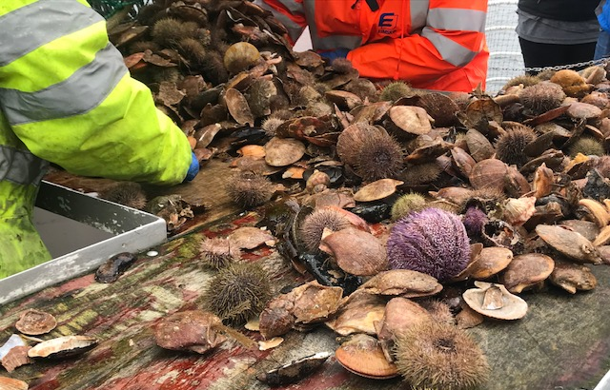
Viking Sushi Adventure Voyage
On an environmental note, a lot of sea creatures were dredged from the sea for this – and it did not feel “right” that they had potentially to suffer or expire just for us to have some scallops. They should have been returned to the sea immediately. It was a gimmick to dredge the creatures up – and not environmentally friendly at all. If the story telling had been more engaging, it would have been fine to have used pre-bought scallops. Icelanders are usually very mindful of their beautiful and precious environment.

Slide 30
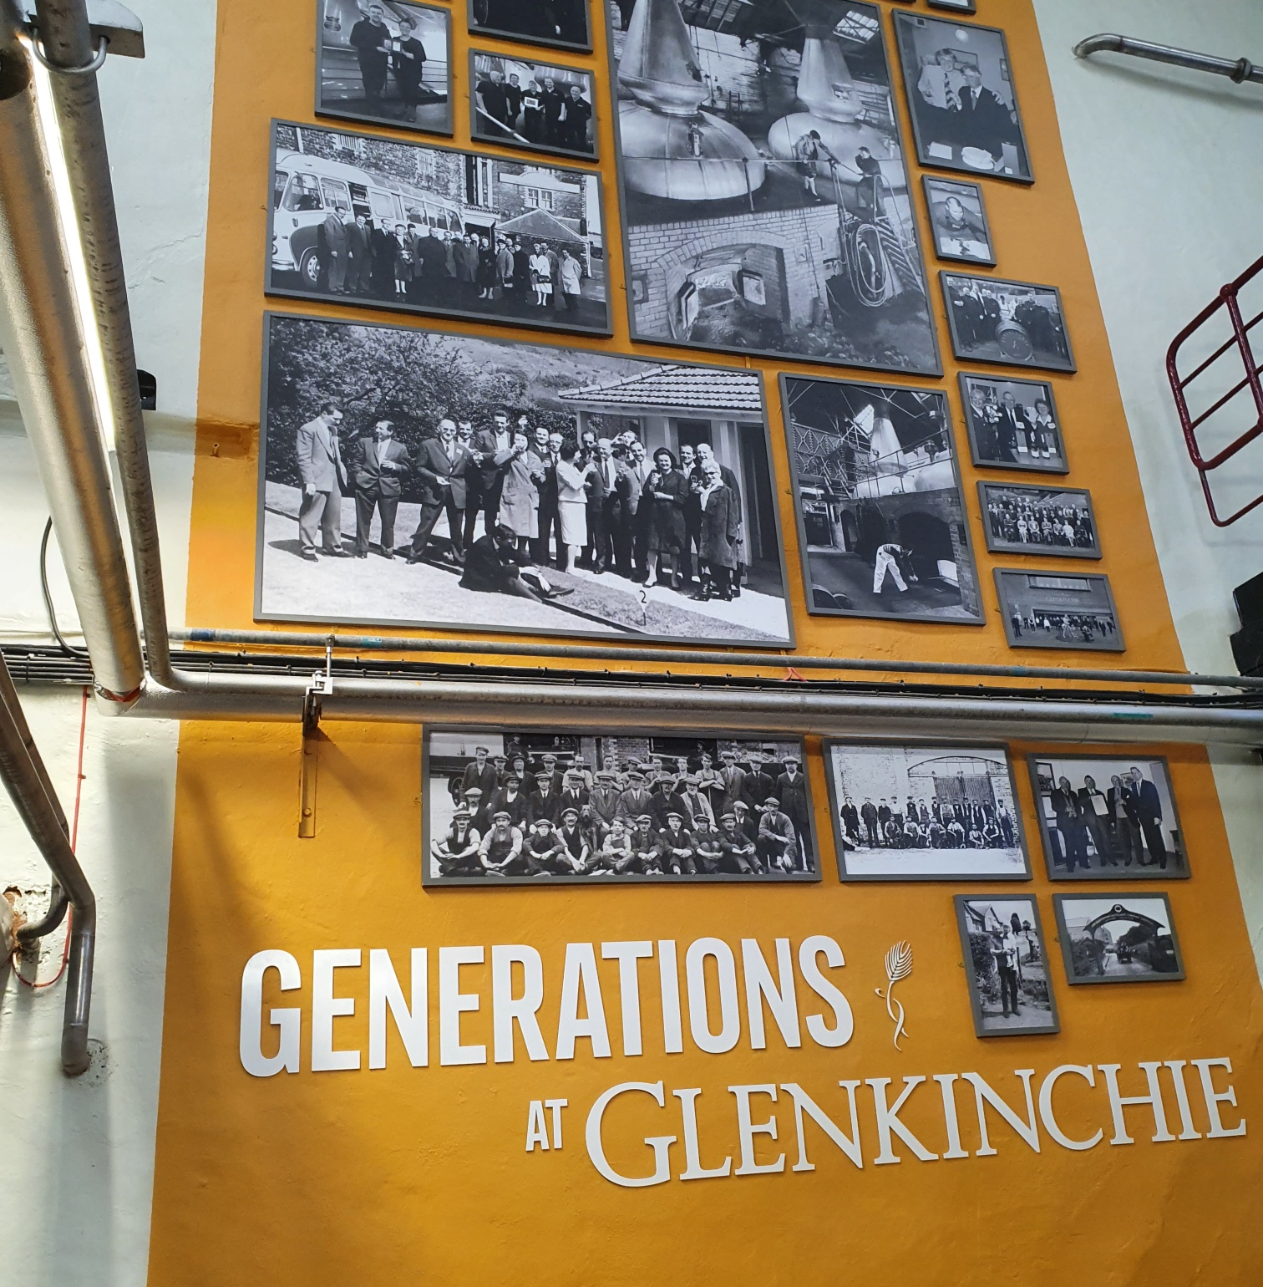
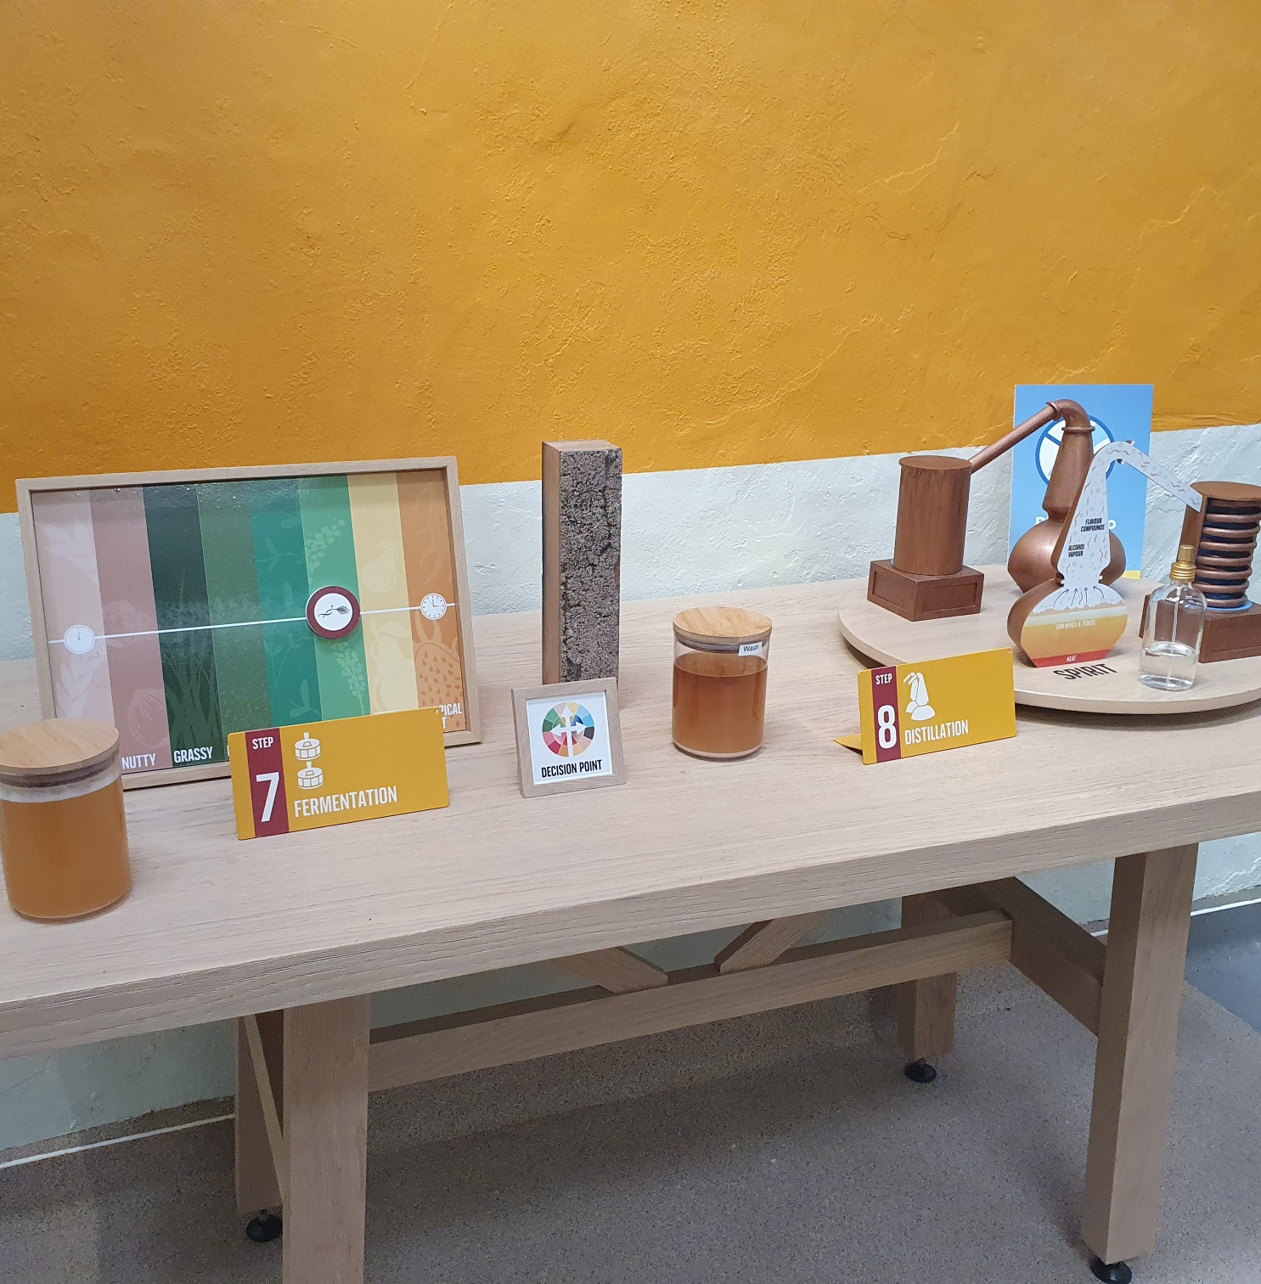
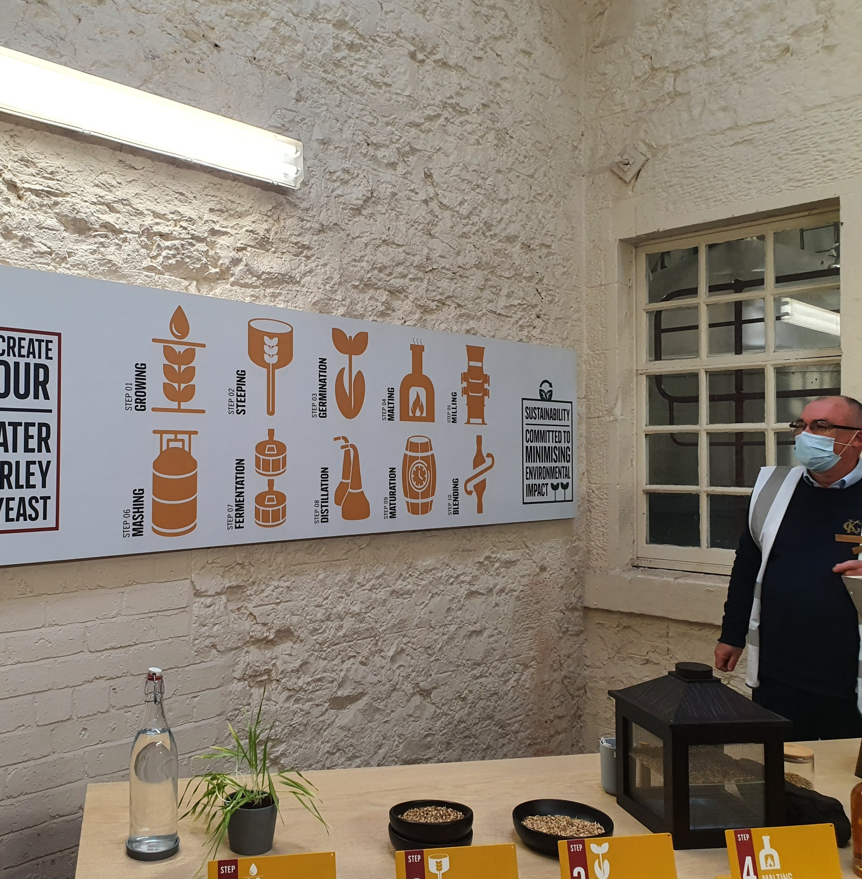
Storytelling with posters and interpretation – a Scottish example (with whisky of course…)
Simple graphics and interpretation
Step by step process
Knowledgeable guide
Heritage photography
Props and opportunities to taste, touch and smell

Slide 31
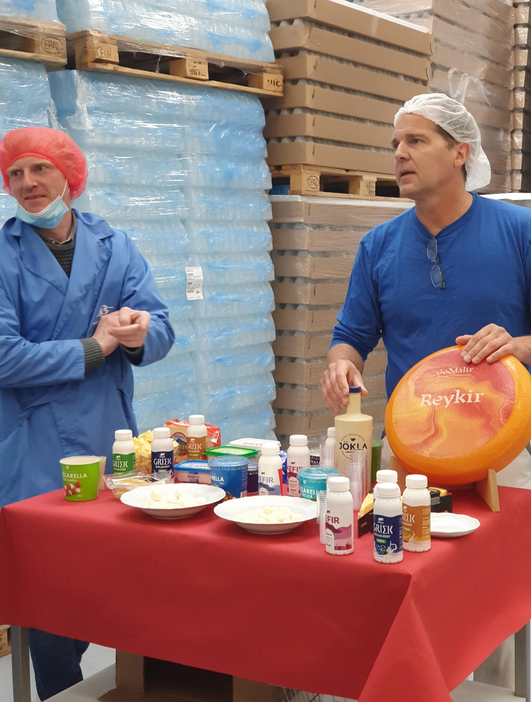
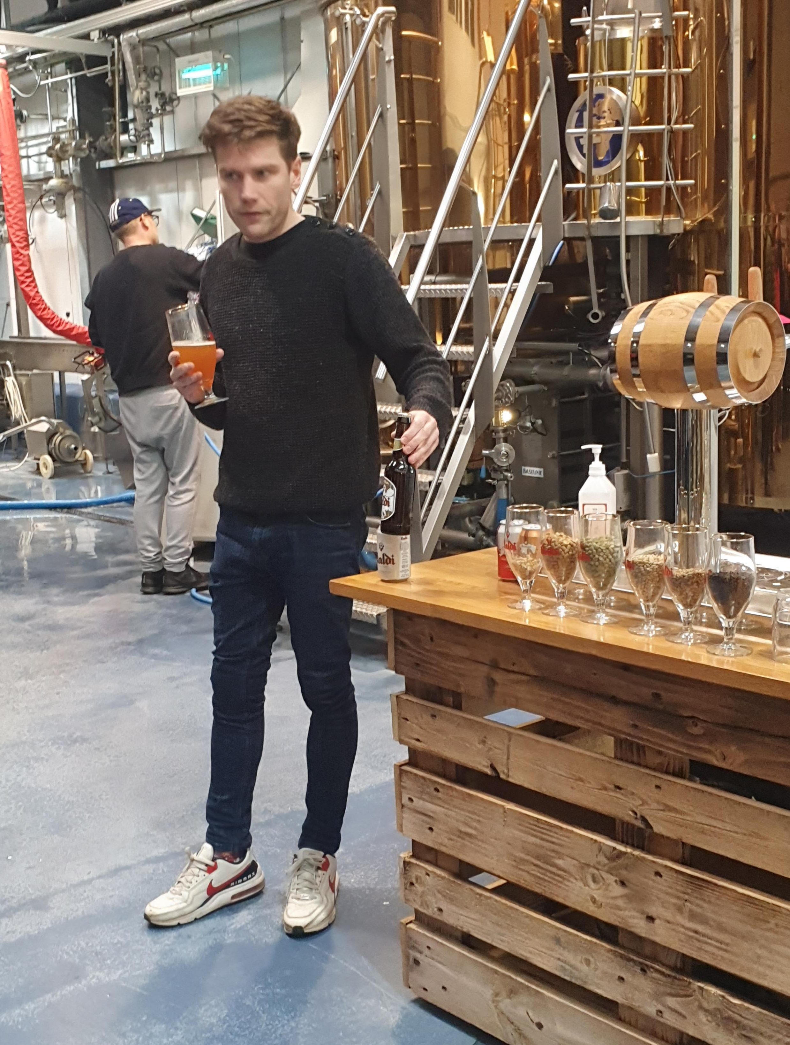
Food production stories and tours - Iceland
Many food manufacturers tell their stories by means of factory tours. We saw a number of these in Iceland including Kaldi Brewery and Mjólkursamlag KS Dairy
Factory tours can be elevated from a traditional production tour with use of props – this was done to good effect at both locations
Tasting also enhances the story – really engaging the customer in the experience (and particularly enjoyable when beer is involved!)

Slide 32
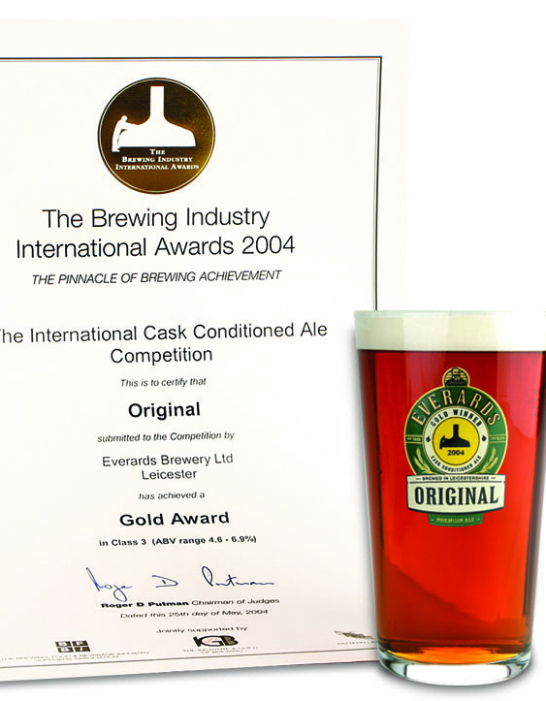
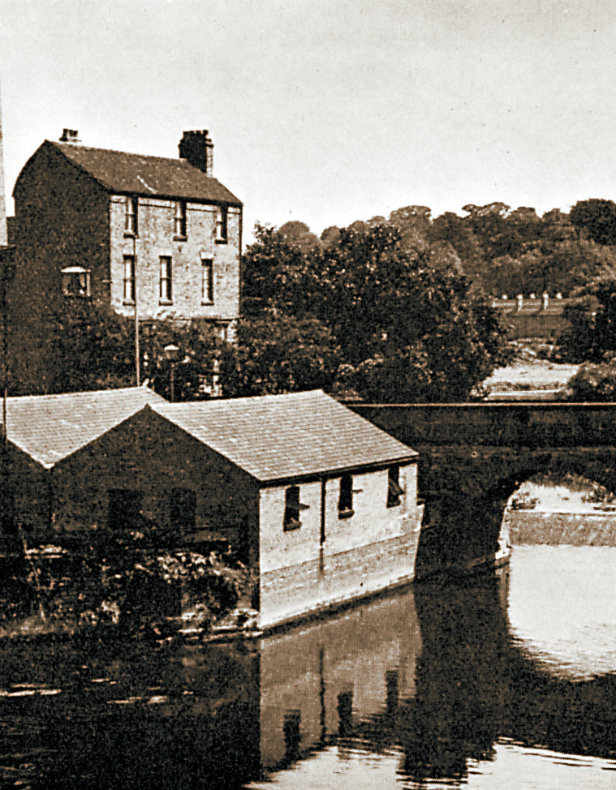
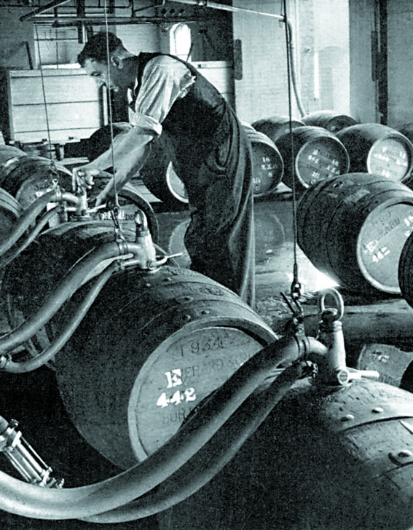
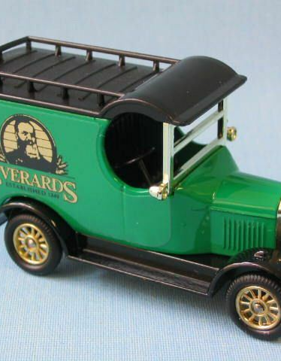
Using heritage and props to tell production stories in the UK – Everards of Leicester Home of great beer and great pubs | Everards of Leicestershire
Departing from the traditional brewery tour, Everards are using props and historic photography to support the brewery tour. Think about how you could use:
Awards
Photographs
Artefacts
Historic marketing material
Toys – for example these Dinky vehicles illustrate how beer was transported in the early years of the brewery

Slide 33
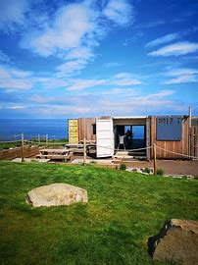
Telling your story online – making good use of your website
There are so many examples of effective online storytelling. Here are a couple:
Jo and Stuart McNicol run Drift, a café with a difference based in a shipping container on the East Lothian coast next to North Berwick
Here Jo tells their story using YouTube:
How we got here — Drift Cliff Edge Cafe — North Berwick, East Lothian (driftalong.co.uk)
A great Icelandic example was from Brimslod Atelier again - beautiful photography and words to tell the story
BRIMSLÓÐ ATELIER WORKSHOP | Brimslod Guesthouse

Slide 34
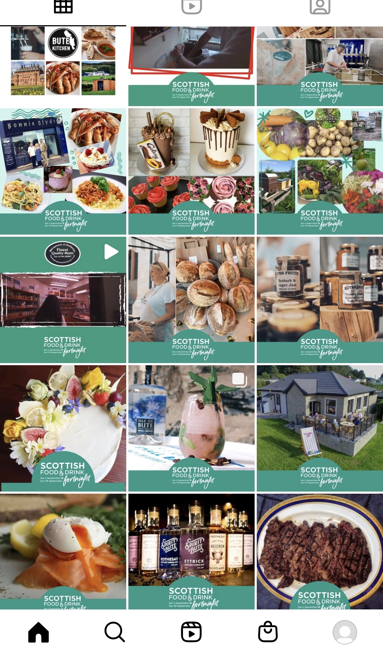
Social media for storytelling
Social media is the latest form of storytelling and it’s a great way to share your stories, join the conversation and reach new audiences.
Whether your preferred channel is Facebook, Instagram or Twitter, don’t forget to use these tools to develop and spread your stories.
A picture tells a thousand words – there is no substitute for a good pic particularly on Instagram.
Bute Kitchen had two weeks of stories and pictures on Instagram during Scotland Food and Drink Fortnight
Isle of Bute Food & Drink (@butekitchen_) • Instagram photos and videos

Slide 35
Step 6 – engaging people in your story
If you have a team, it’s really important to engage the in the company story Help them find ways to make their own links to the story so they feel they “own” it too. It will make their interactions with customer more powerful and authentic.
Identify who the storytellers are in your business, who needs help to tell the stories and who are the naturals. Think about props and materials to help them tell the stories.
Storytellers could be:
You
Your family
Your team
Your suppliers
Your customers

Slide 36
Step 7 – keep evolving your story
Keep evolving your story
We’re all busy – but it’s really important to keep stories live. A website that hasn’t been updated for a few years can be a real turn off – it feels like the company “doesn’t care” even though its probably either a lack of time or technical know how
Make sure your stories are up to date and show where you and the business is right now.

Slide 37
Owning your story – some writing advice
Most of us are scared of writing and often don’t write our stories as we can’t think how to start. Sometimes our tone comes across as very formal or distant – as we’ve been taught to write “business style” at school or college.
With a story, try writing as you would speak. Perhaps record yourself telling your story and then write down what you said, or ask someone else to.
I and WE. Use I and we as this helps you to OWN your story and it’s much more interesting for the listener. Compare these two sentences:
The company was founded in 2005 with an initial small cash injection.
I started Bluestarfish in 2005 after being made redundant…
Which one are you more interested in? When we use “I” and “we” we are making the sentence active – that is to say the reader or listener knows who is doing the action. In the first sentence, there is no clue as to the person who started the company. Stories are about people….your customers want to know about you….so tell them!

Slide 38
6 top tips
Make it personal – include family and daily activities, family history and tell the listener/reader how you feel
Be honest but positive – don’t only tell good news stories. Overcoming adversity and facing challenges resonates with the reader.
Use humour – try to entertain, be funny if possible and create mini scenarios for maximum impact.
Explain why you do what you do not just what you do – explain what motivates you, your purpose and passion.
Focus on your uniqueness – what is special about your story? Why are you or what you do special – stand out from the crowd.
Write a conversation – keep it chatty; it doesn’t need to be perfect prose. Consider your story being told as a diary.

Slide 39
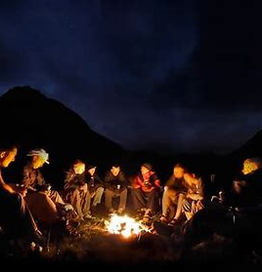
Summary
Storytelling isn’t just an add on to your business; it should be at its very core
Take some time, sit down with a chum and start thinking about your story
Work through the 7 steps
And then tell your story to the world - good luck!

Slide 40
Further reading, resources and useful links
Year of Stories 2022 - Marketing Toolkit | VisitScotland.org
https://hbr.org/2014/10/why-your-brain-loves-good-storytelling
https://talesfortadpoles.ie/blogs/news/the-power-of-storytelling-and-how-it-affects-your-brain
https://teq.queensland.com/industry-resources/how-to-guides/storytelling

